Slide 1

HK TREE WATCH
A natural science survey system
Final Submission
Version1.1
http://www.hktreewatch.org
Notes:
Hello, we are HK TREE WATCH. My name is Rishi and allow me to briefly talk about our Project aims and Objective with this application We built this application to meet the functional requirements of our client.
What we will show you today is the very early alpha demonstration of our natural science survey system, with a focus on tree management and survey knowledge for the general public. We hope to improve this application, with your valuable feedback as time goes on .

Slide 2
VISION
To enable researchers and the general public to report on Hong Kong's diverse flora & fauna.
Create a love of nature
Notes:
So what is our VISION, and why did we build this app?As the description says we want to enable researches and the general public to gain knowledge and insight from Hong Kong’s unique and diverse ecosystem. We hope that this application will help many organizations including our client to uplift the quality of their living environment through active planning, maintenance and preservation of trees and other vegetation. To summarize, in one line, we hope that our application can simply “CREATE A LOVE OF NATURE” , in fact this is what our client had requested.

Slide 3
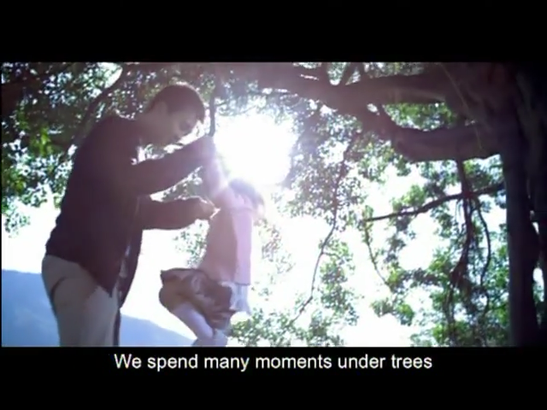
VIDEO
Before we begin the demonstration, I want to introduce a short video which will summarise our goals. This video was created by the HK Government and was recently showcased on TVB pearl (local tv station), this video will clearly highlight our aims and objective for this project. (Length: 30 seconds)
source: ISD, Hong Kong Government
Notes:
Before we being the demonstration, I want to introduce a short video which will correctly summarize our goals, in fact this video was created by the Government and was recently showcased on TVB pearl, this video will clearly highlight our aim and objective.
I hope now you better understand why we build our application and why we need the general public support and NGO’s to monitor and survey our trees & bio diversity.

Slide 4
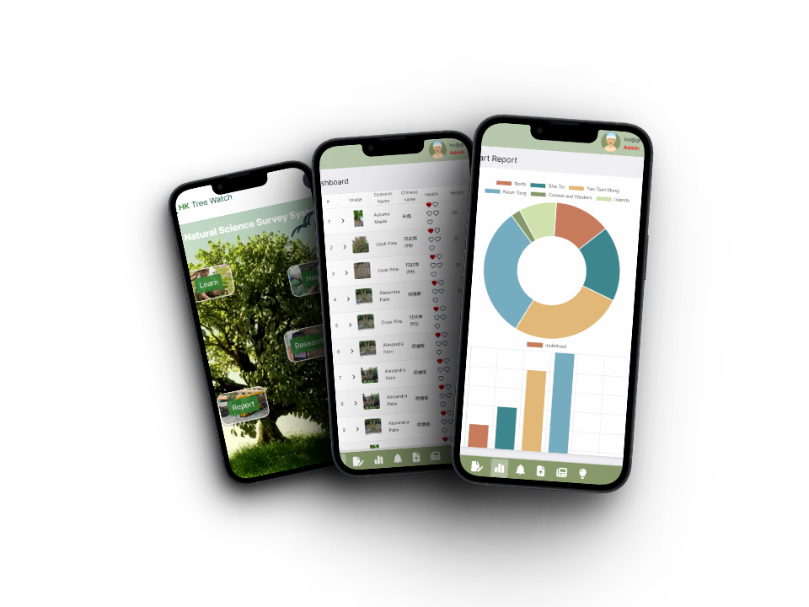
PEOPLE, TREES, HARMONY
How did we achieve this?
Modern UI/UX
Responsive
~1.5s loading time
Single code base / Multi platform
Follows common design principles
Follow clients branding theme
Accessible (semantic HTML, alt text, aria labels)
Secure (OWASP compliant)
Adhere to Legal, Social, Ethical & Professional issues
Engagement
Notes:
How will our Achieve this?
- Modern user interface, legible text, good contrast with background and foreground, remember that our application will likely be used outdoors most of the time.
Responsive which means any device, anywhere with the same functionality, we can’t code for all devices and sizes, and with a limited budget responsible makes the most sense.
Single code base, this is mainly for Developer experience and maintainability for future developers who are working on our repository.
Follow common design principles, which include (Visibility, Good user Feedback, Constraints for different activities and , Consistency across screens & Affordance which is to make the application easy to use without needing a 500 page manual to understand it.
Security is very important, if we are handling sensitive user data we must follow some core OWASP & LSEP principles. At this stage it is a work in progress but we hope to complete it soon.
Engagement, there is no use to build a app if no body is going to use it, so we have plans to get as many hands on our application, and we will talk about this in our final demonstration to the client.

Slide 5
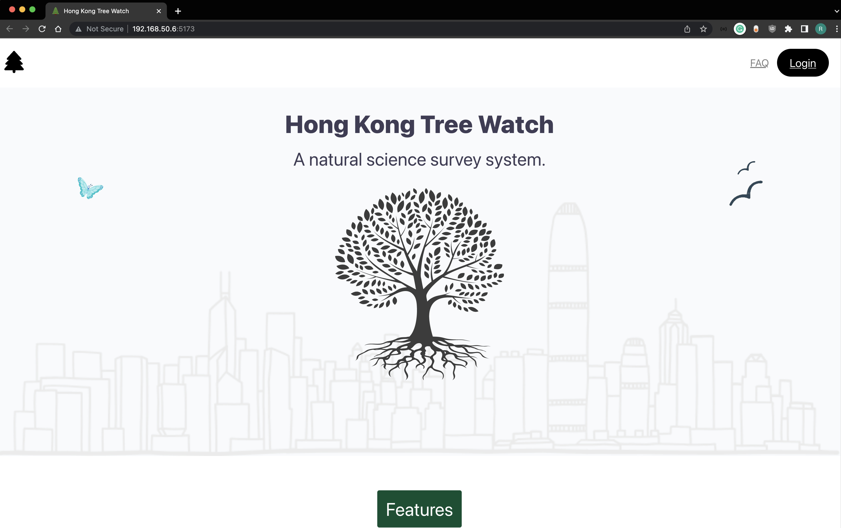
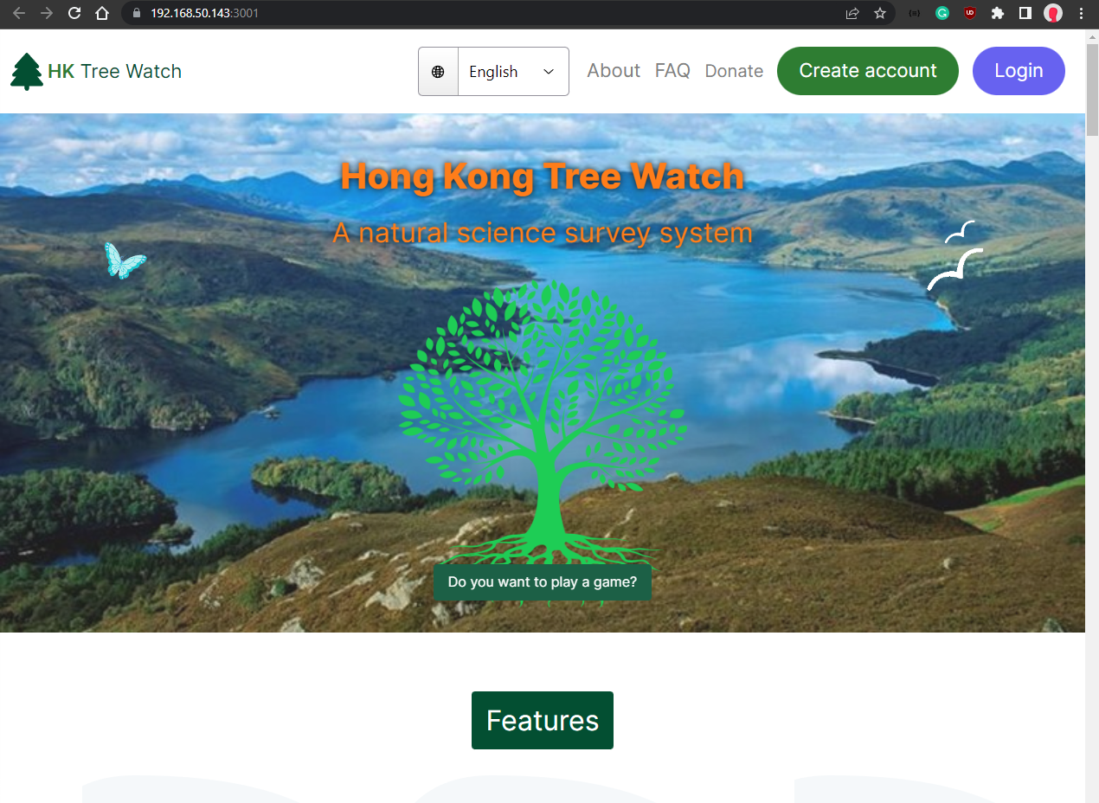
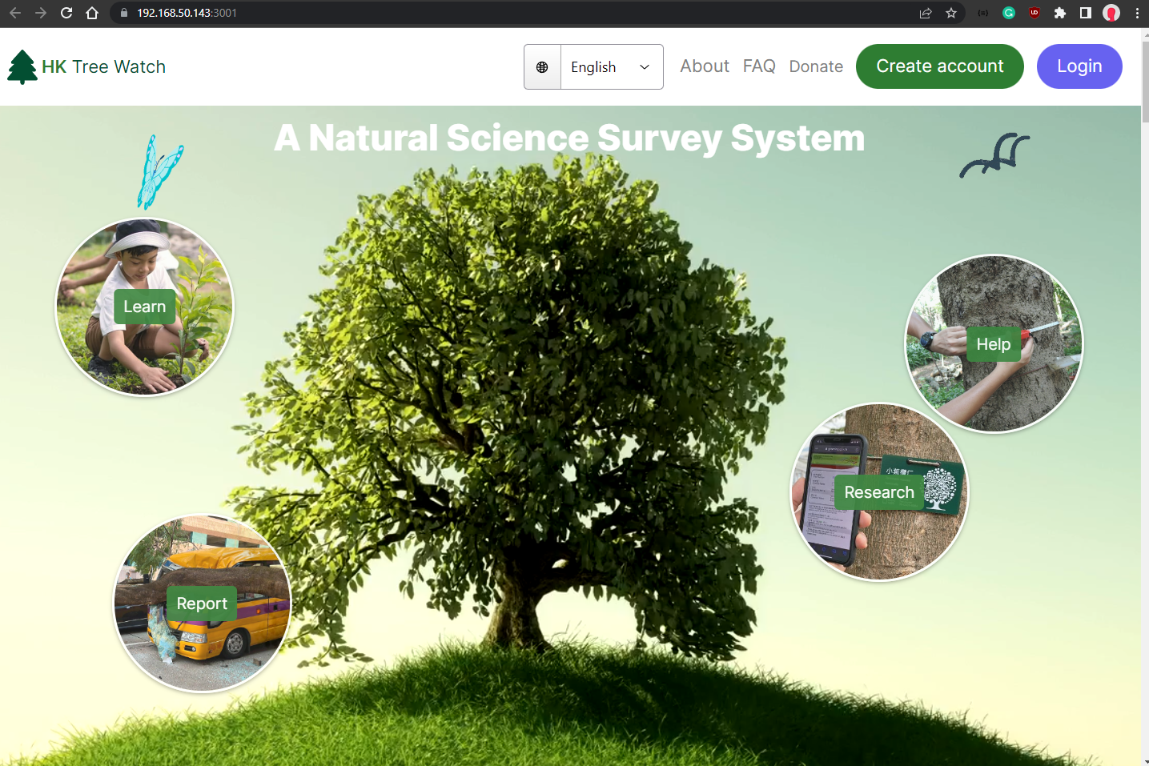
Mockup, Feedback, Iterate
Ver 0.2
Ver 0.8
Ver 1.0
PROGRESS
Notes:
Demno Time.

Slide 6
Functional Requirements Met
Server Component | 🗸 | Java Backend
Database | 🗸 | MySQL
Multiple Device Support | 🗸 | Responsive
Predefined Species List | 🗸 | Master Tree Table
Survey | 🗸 | Crete, Read, Update Delete
Activity Records | 🗸 | Logging
Admin Features | 🗸 | User Edit, Survey View
Export & Import | 🗸 | TSV Import / Export
Notes:
Demno Time.

Slide 7
Advanced Feature Table
Image Storage | 🗸 | Alibaba Cloud Object Storage Highly Reliable & Secure
Interactivity | 🗸 | Home Page Quiz
QR Code Link | 🗸 | Tree ID
CDN |  | Cloudflare backbone, CDN, WAF
Fallen Tree Report | 🗸 | Report to HK Govt
Gamification | 🗸 | Users get points
Artificial Intelligence | 🗸 | Tree Prediction
Notes:
Demno Time.

Slide 8

Security
Authentication & Authorization | 🗸 | Tokens-based authentication. No plaintext passwords storage Industry Standard for web applications
Encryption | 🗸 | SQL DB is encrypted at rest using AES-256, TLS 1.2
Input Validation | 🗸 | Form Validation, Backed Validation
Access Controls | 🗸 | Constrained Views based on role permission
Security Controls | 🗸 | Activity Logging
Privacy | 🗸 | T&C, PDPO Compliant
DDoS | 🗸 | Detection of DDoS
OWASP | 🗸 | Data Integrity, WAF, Injection
Notes:
Demno Time.

Slide 9
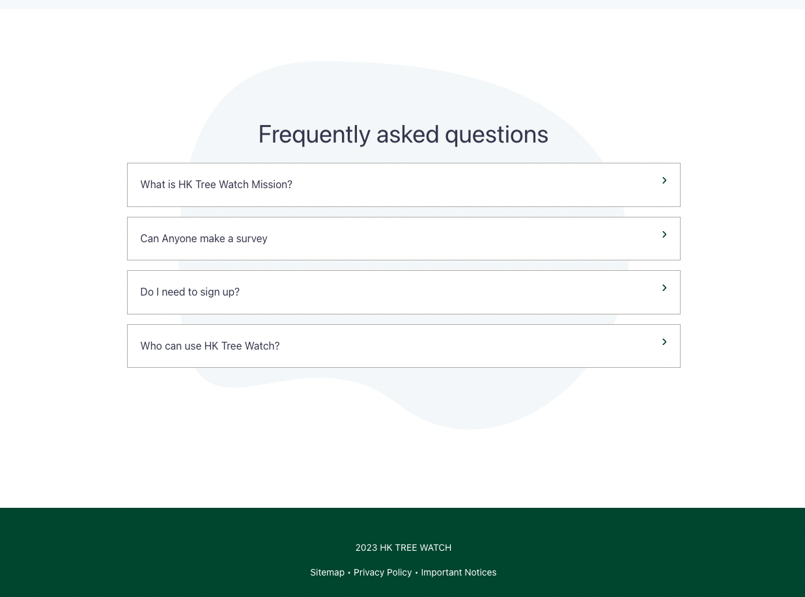
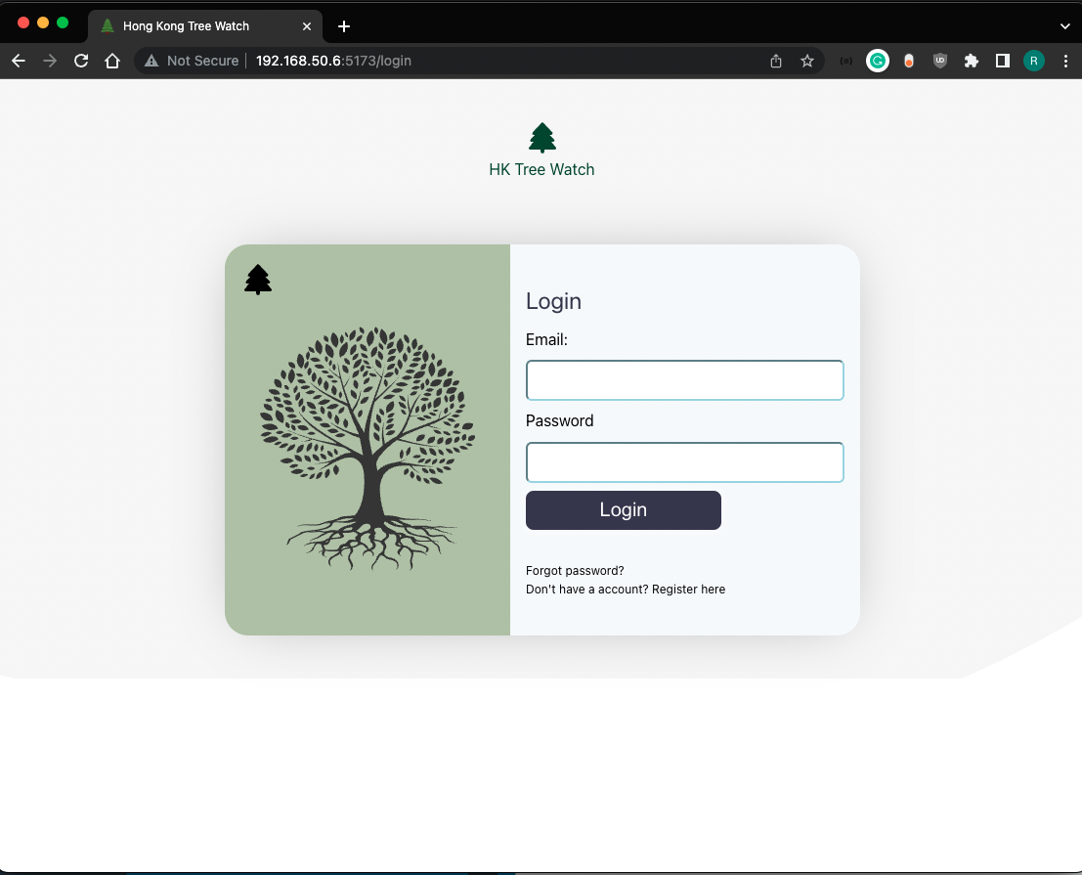
Product Demo
(Screenshots)
Notes:
Demno Time.

Slide 10
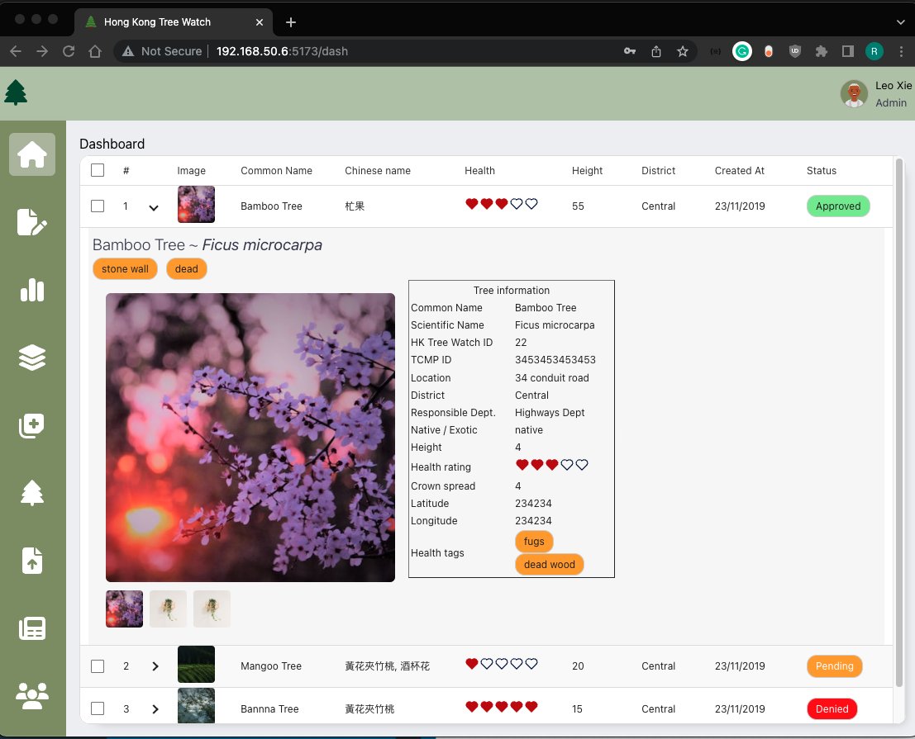
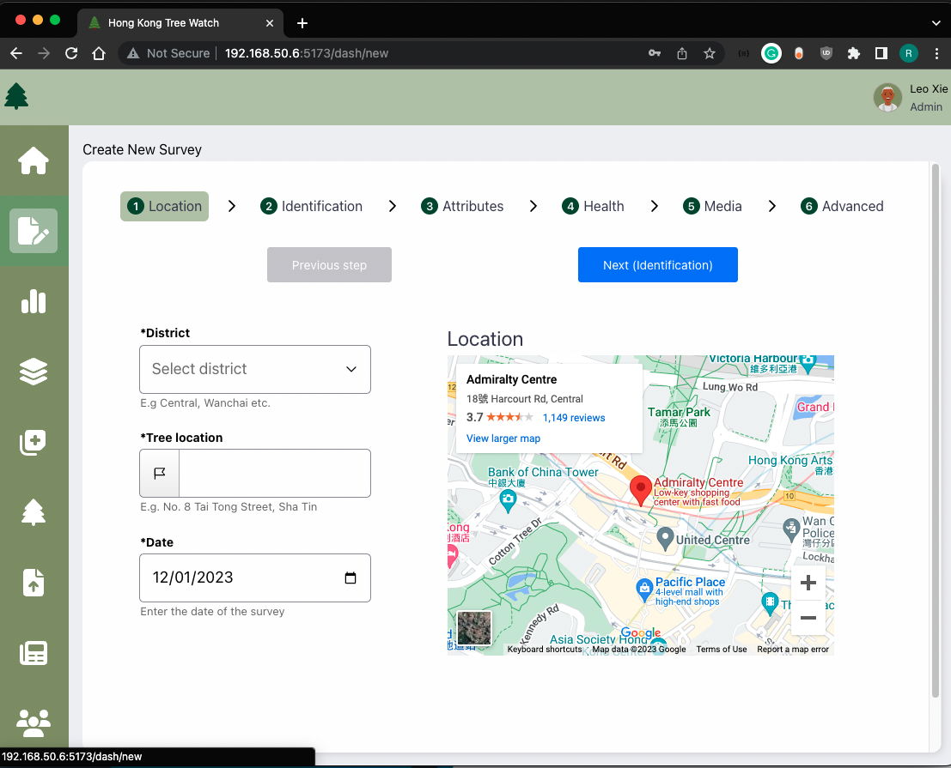
Product Demo
(Screenshots)
Notes:
Demno Time.

Slide 11
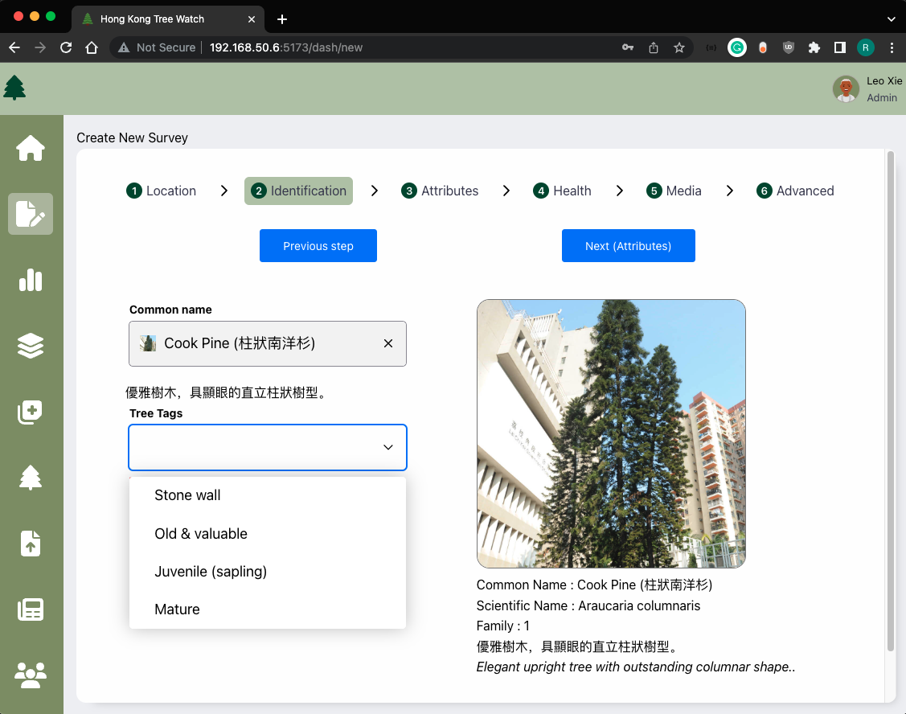
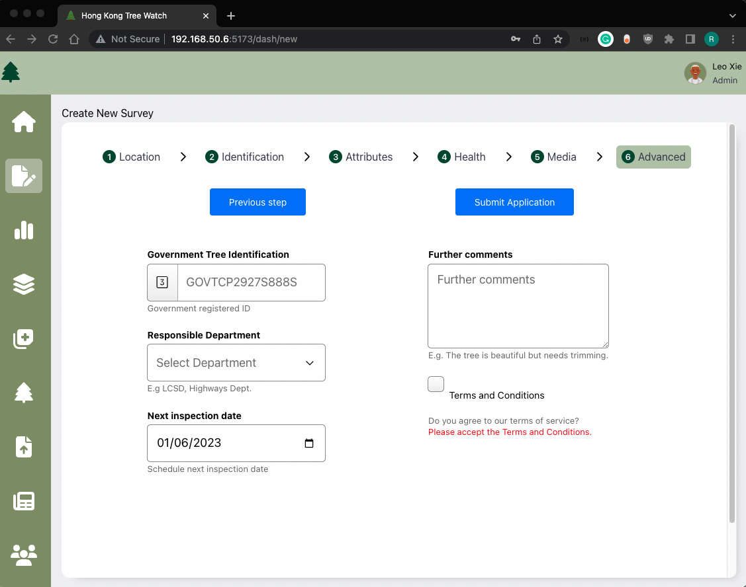
Product Demo
(Screenshots)
Notes:
Demno Time.

Slide 12
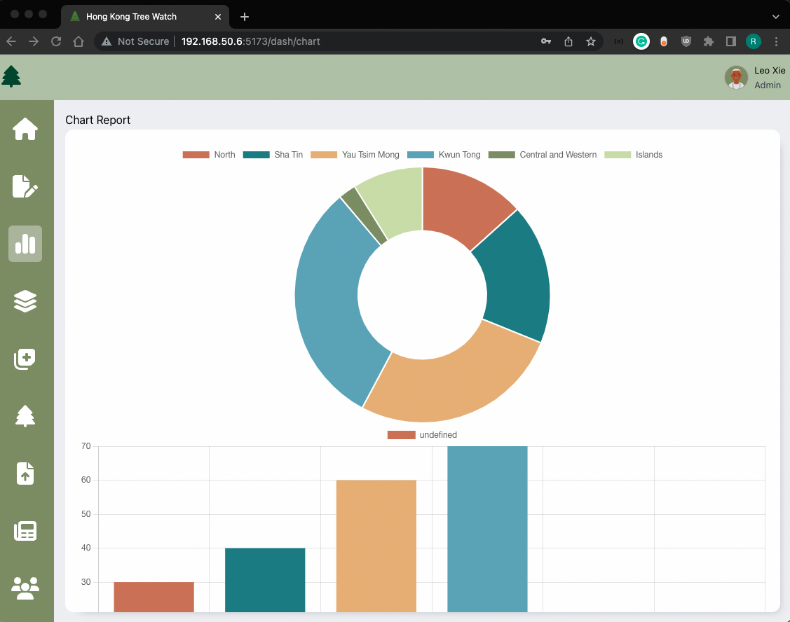
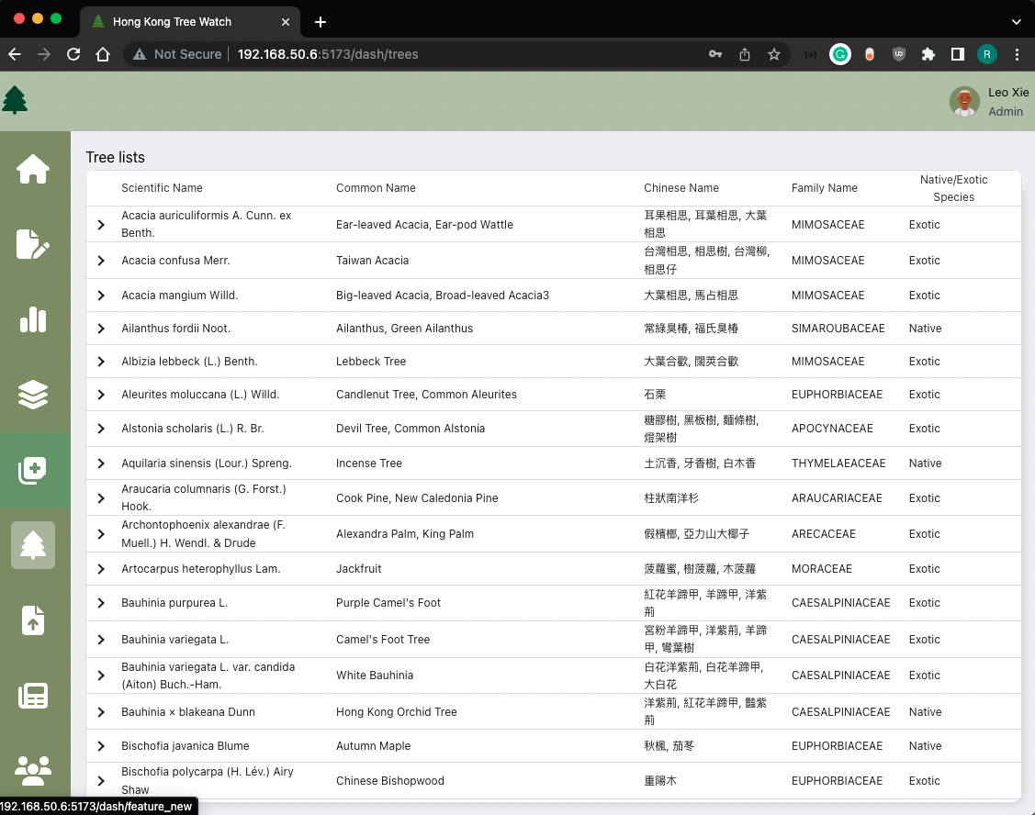
Product Demo
(Screenshots)
Notes:
Demno Time.

Slide 13
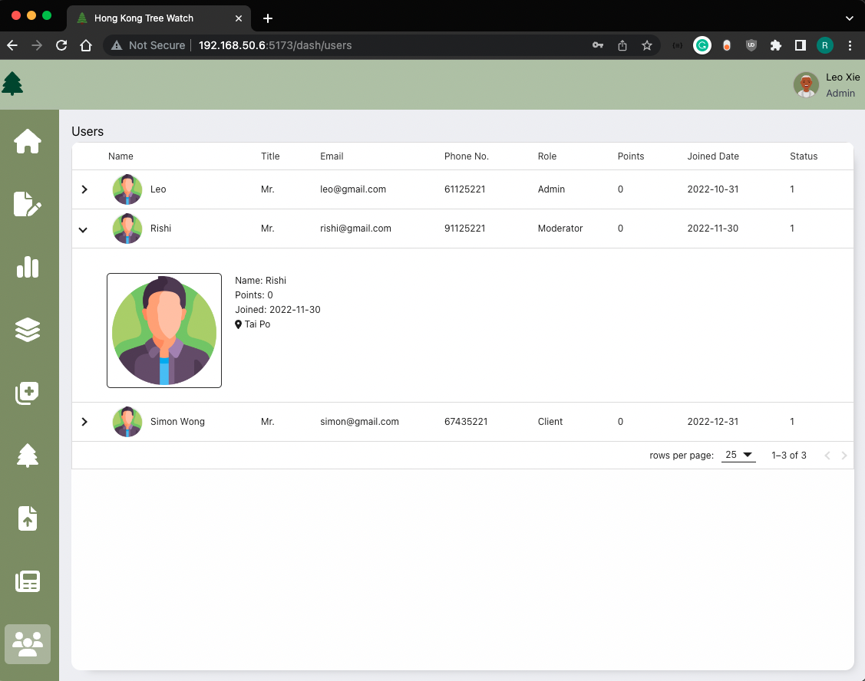
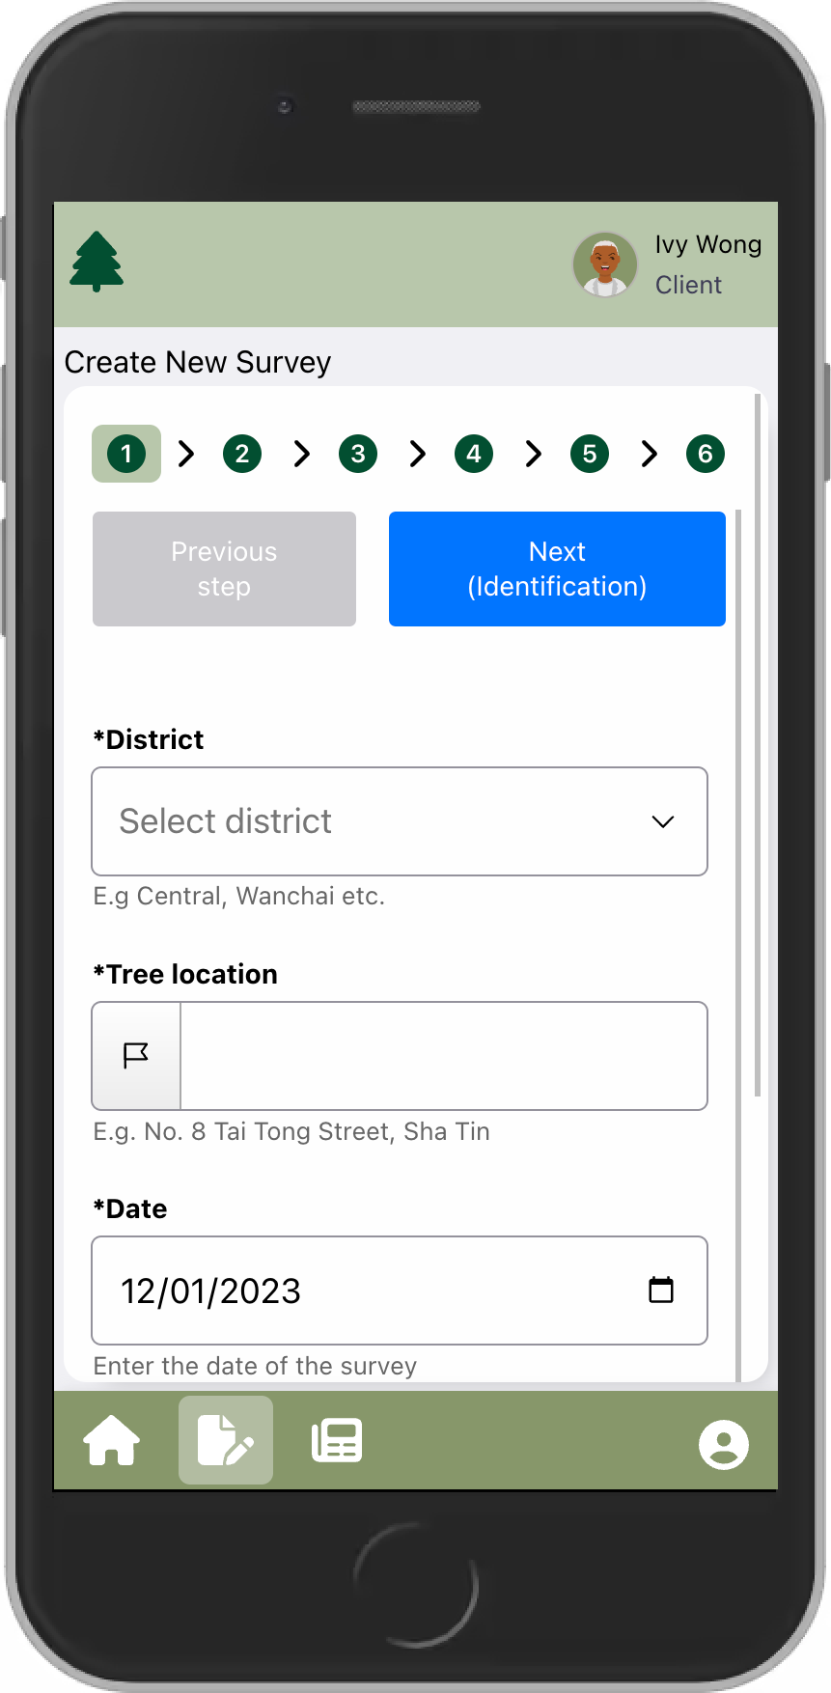
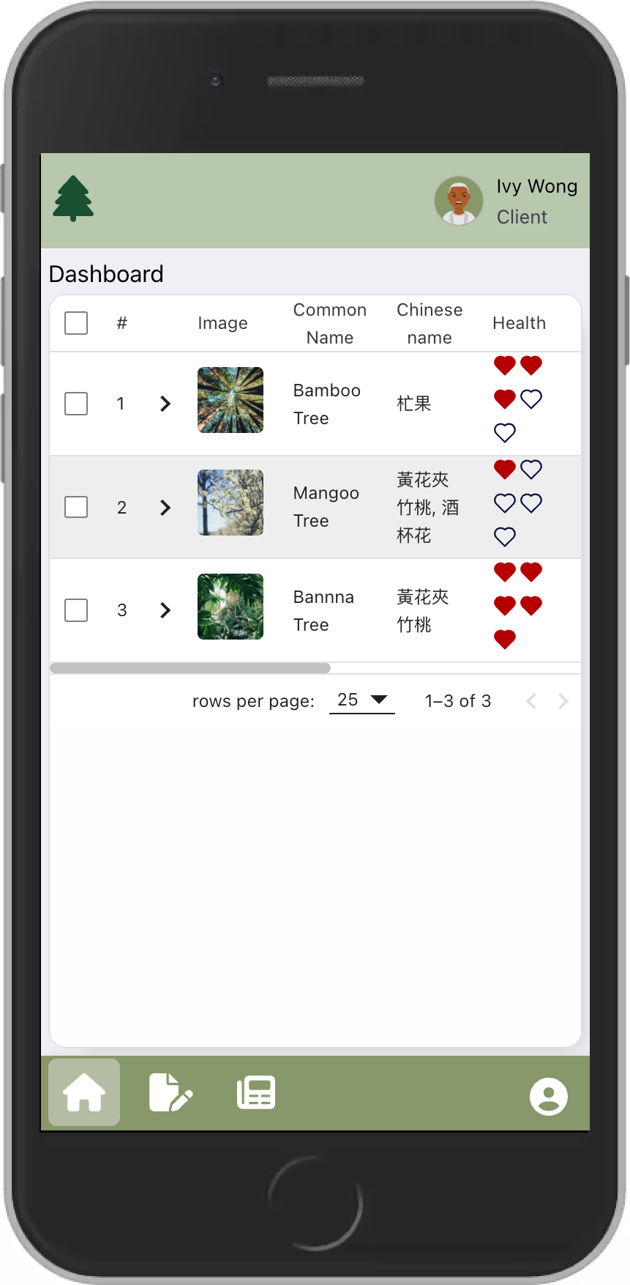
Product Demo
(Screenshots)
Notes:
Demno Time.

Slide 14
Maintenance
24/7 Phone troubleshooting support day or night (Call Simon & Leo)
99.999% Uptime SLA & 6 Month software warranty assurance
Full Documentation handover (API, Testing, Requirements)
Code base Handover (Github, Amazon, Object Storage)
Training Materials handover in documentation
Fully Licensed. Client retains exclusive ownership of software.

Slide 15
Future Roadmap to Ver 2.0
Integrate with Government API (not currently available)
Enhance Content Management System for Moderator.
Pre-train model on more robust classification of species, increase accuracy
Single-Sign on & Biometric Authentication support
Progressive Web Application, Offline support.
Dark color theme switcher
On going summative usability studies for UI/UX improvments
Automated transactional email notification system (AWS SES)
Real time notifications using WebRTC API using Websockets
Government Funding for future expansion
Points / Rewards Scheme adoption with local retailer support

Slide 16
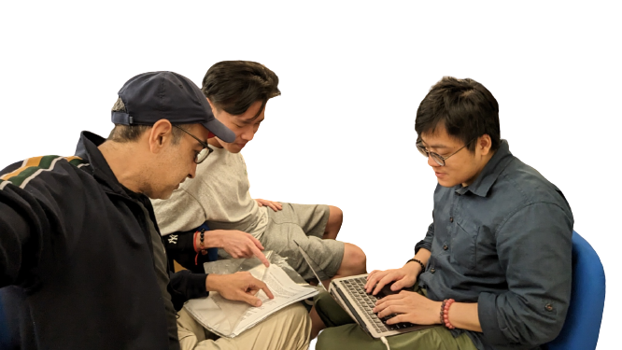
Acknowledgments
LEO
Technical Lead
RISHI
Scrum Master
Product Owner
SIMON

